Slide 1


Centre for Digital Public Infrastructure
Financial Address Mapper
for G2P Payments
DPI Building Block in Focus

Slide 2


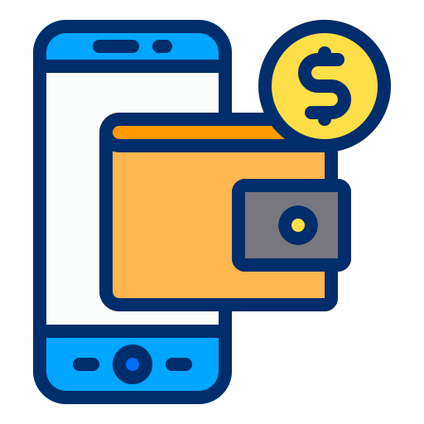

Status Quo
Programs sometimes impose specific
payment modes on beneficiaries based on their arrangements
with banks
Gov’t Program 1
New or Specific
Bank Account(s) Required
(Based on bilateral tie-ups)
Beneficiary has a Mobile wallet/bank account

Slide 3




Gov’t Program 1
Gov’t Program 2
Gov’t Program n
Status Quo
Even if they can use an existing account, individuals must usually re-provide similar information to each program
Eligibility Details &
Bank details
Eligibility Details &
Bank details
Eligibility Details &
Bank details

Slide 4
The standard approach is to centralise all beneficiary information into a shared database
Including bank account details, identifying information, eligibility criteria, etc.
Gov’t Program 1
Beneficiary Database
Gov’t Program n
Digitisation
Approach
Eligibility Details &
Bank details

Slide 5
Gov’t Program 1
Beneficiary Database
Gov’t Program n
This solution looks good on paper, but tends not to work at national scale!
Eligibility Details &
Bank details
Difficult to maintain
Unwieldy large database
Dynamic rules & data
Political will to align all departments

Slide 6
Instead, consider separating eligibility information
From
financial information
Varies across departments;
Leave in department control
Minimal & constant across departments

Slide 7

Unbundle the problem
Create a minimal, reusable, privacy preserving utility across departments using open APIs
Give individuals
choice of account &
accessibility across multiple payment modes
Leverage a
Digital Public Infrastructure (DPI) Approach to G2P

Slide 8
One of the
Building Blocks of G2P Connect
open blueprint
https://github.com/G2P-Connect
Financial
Address
Mapper
A 4-field registry allowing any
gov’t program to send money to a beneficiary using only an identifier*
Sometimes referred to as a
Financial Account Mapper
*Note: Architecture allows any verifiable identifier to be used, e.g. unique ID, national ID, social protection ID, mobile number, etc.

Slide 9
Financial Address Mapper can let beneficiaries access money interoperably across any kind of account - creating choice
Financial Address
(ID Number; Mobile Number; Name@bankname; etc)
Mobile Wallets
Banks

Slide 10

For Government
Programs & Depts,
A Mapper:
Avoids maintaining sensitive financial info
Avoids re-collecting financial info again for new schemes/programs
Avoids creating new accounts or fresh KYC processes, and uses beneficiary’s existing accounts
Reduces bounces & grievances: Customers can change banks in one system without re-updating with every program
Drives new use cases such as salaries, pensions, & scholarships using same G2P infrastructure

Slide 11
Design Principles
Design Principles: Mapper
Minimalism
Interoperability
Innovation
Asynchronous
4 data fields
Any bank, any wallet, any device, any program
Allow banks & Mapper to enable diverse interfaces for update
Programs adopt Mapper usage voluntarily and asynchronously based on readiness
Privacy & Security
Inclusive &
User Centric
+1 Change
Evolvability
Make a minimal change to existing programs (collect identifier instead of financial info) rather than re-engineer their whole process
Future types of accounts or auth modes enabled
(Bank; mobile wallets, crypto, etc; PIN auth, face auth; mobile auth, etc.)
Sensitive financial information provided to minimal databases
Available online/offline
Update info flexibly and only once with bank or directly with mapper

Slide 12
A Mapper should offer
simple APIs
Financial
Address
Mapper
Status Check API
Link/Unlink
APIs
Resolve
API
“Is there a financial address/ account number for this ID number?”
“Please add/remove this financial address for this ID number”
“What is the financial address/account number for this ID number?”

Slide 13






Payment
Switch
Financial Address Mapper In Practice
ID# and Amount
Account Info
(Resolve API)
6
7
8
Gov’t Dept Bank Account
Mapper
Identifier
Number
Bank/Mobile Wallet a/c #
2222222
789
ID# and Amount
33333333
456
4444444
123
Account
Preference
Link API
Verify linkage of ID with account
(Status API)
Account
Preference
Link API
5
2
2
2
4
2
Gov’t Dept a
n Programs
ID#
Beneficiary Store of Value
Account
ID#
1
9
3
*Note: Using additional open standards for cash-in-cash-out can allow beneficiary to draw cash using any agent/any micro-ATM device

Slide 14

At an ecosystem level, this prevents duplication
Gov’t Program 1
Gov’t Program 2
Gov’t Program n
Eligibility Details
Eligibility Details
Eligibility Details
Mapper
Financial Details

Slide 15

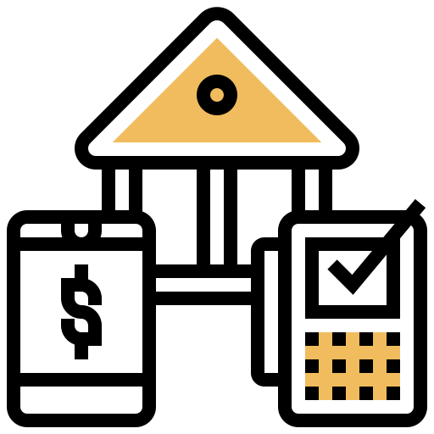
Mapper
Prerequisites
Verifiable
Identifier
Payment
System
One or more ID systems/ identifiers with the capacity to authenticate the individual
(via mobile one-time-password,
offline QR codes,
face authentication, fingerprint/iris, etc)
One or more existing payment method/ switch between banks

Slide 16

$
Many institutions can host a Mapper
And a country can have more than one Mapper
A Payment switch, Central Bank,
any one G2P program, a department
with a collection of G2P programs, etc.
As long as each is available via open APIs

Slide 17


Open Source can be used to create a Mapper faster and cheaper, while still retaining full control
Or you could build one from scratch yourself in house or via a vendor

Slide 18
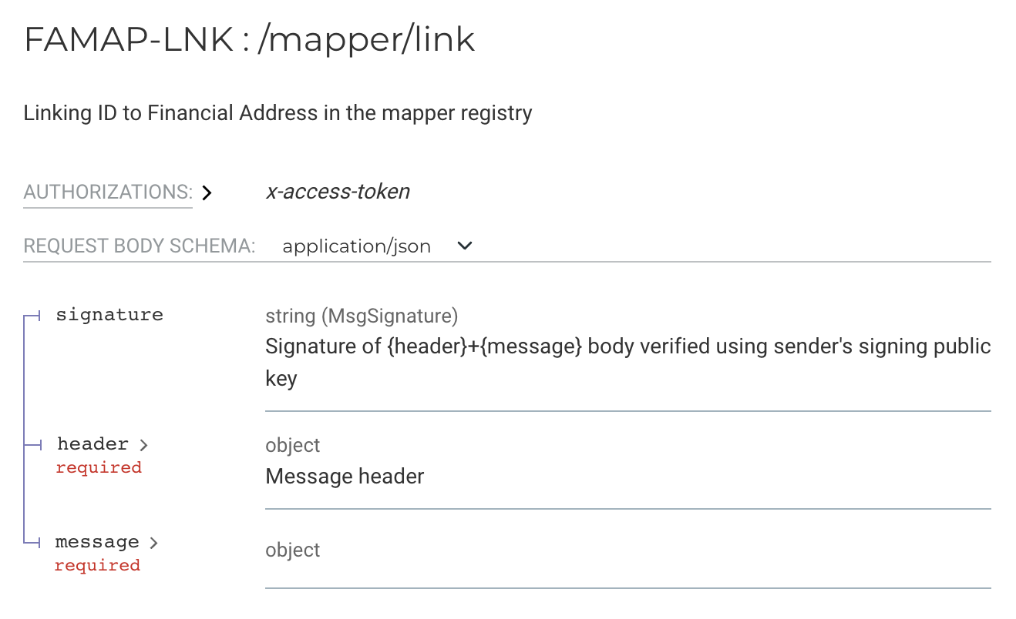
Either way,
leverage these simple open specifications
for a Mapper
to give your tech team a how-to guide to implement
And ensure interoperability across your country’s G2P ecosystem
https://g2p-connect.github.io/specs/dist/g2p-mapper.html

Slide 19

Thank you!
https://g2p-connect.github.io/specs/dist/g2p-mapper.html
Centre for Digital Public Infrastructure

